Slide 1
Waveforms for 5G Brief Introduction
Long Zhang
Hardware Engineer
Tieto Oyj, ZSR Product Development Services /
long.a.zhang@tieto.com

Slide 2
Table of contents
Motivation and Background
Major Multicarrier Modulation Candidates : FBMC, GFDM, BFDM, UFMC and FTN
Waveform Choice and Comparison

Slide 3
天地之间，其犹橐籥乎? 虚而不屈，动而俞出。 ——老子《道德经》

Slide 4
Motivation and Background
Very large data-rate wireless connectivity, requires a modulation scheme with large spectral and energy efficiency
Internet of Things (IoT) , requiring a modulation scheme robust to time synchronization errors and performing well for short communications
Tactile Internet, reliable and have small latency
Wireless Regional Area Networks (WRAN) , be able to efficiently exploit the available fragmented and heterogeneous spectrum.

Slide 5
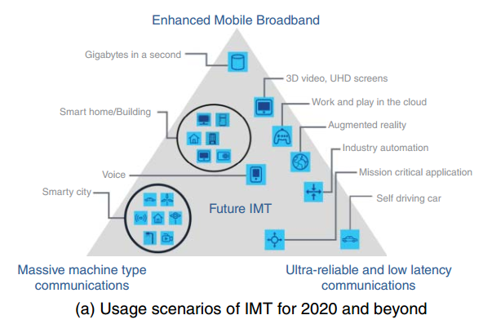
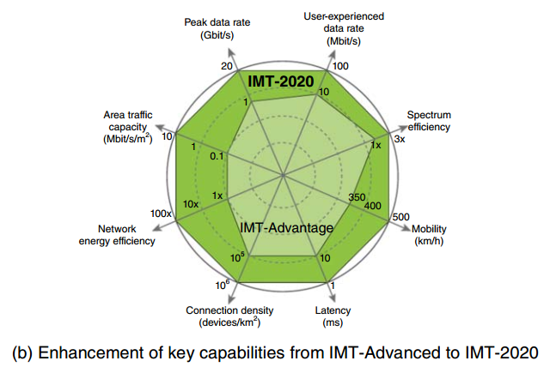
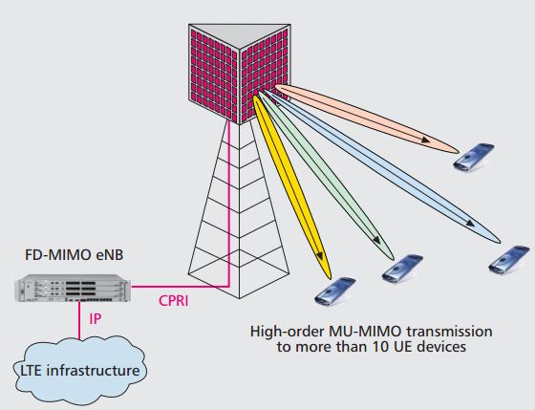
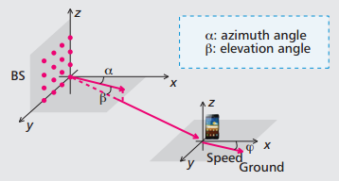
5G Standard Development
R-13
full dimension MIMO (FD-MIMO)
licensed assisted access (LAA, only downlink) ; carrier aggregation with up to 32 component carriers
further cost reductions for MTC(NB-IoT)
R-14
in case of FD-MIMO, antenna ports up to 32
LAA support uplink
expected to introduce latency reduction technologies, e.g. grantless procedure; shorten the TTI length
vehicle-related services (V2X, e.g. vehicle-to-vehicle (V2V) , vehicle-to-infra (V2I) , vehicle-to-pedestrian (V2P) ) within the scope of the study; latency reduction, multi-cell multicast/broadcast meet industry and regulatory requirements
Notes:
LTE TTI 1ms = a subframe = 2 slots = 14OFDM, HSPA TTI 2ms, UMTS TTI 10ms, A shorter TTI is for fast link adaptation and is able to reduce delay and better exploit the time-varying channel through channel-dependent scheduling. LAA aims to use unlicensed spectrum as a complement for LTE systems operating in licensed spectrum to meet the sharply increased demand for wireless broadband data

Slide 6
Chief Advantages of OFDM and OFDMA
the ease of implementation of both transmitter and receiver thanks to the use of FFT and IFFT
the ability to counteract multi-path distortion
the orthogonality of subcarriers, which eliminates intercell interference
their easy coupling with adaptive modulation techniques
the ease of integration with multi-antenna hardware, both at the transmitter and receiver

Slide 7
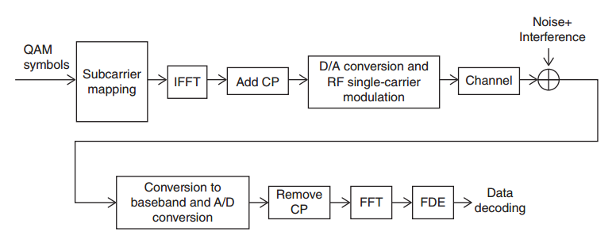
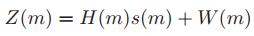
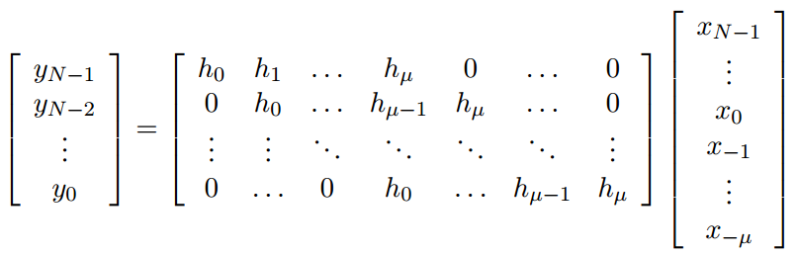
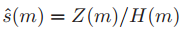
OFDM
K QAM symbols (s(1),s(2),... ,s(K)) is mapped onto the available K subcarriers
Soft estimate of the symbol s(m), to be sent to the data decoding block

Slide 8
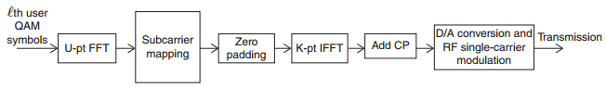
SC-FDMA
U denote the number of subcarriers (out of the available K) that have been assigned to the L th user in the current resource slot, a block of U QAM symbols is FFTed and mapped onto the assigned subcarriers
“Zero padding” block forms a vector of K elements
According to the OFDMA, active users must transmit synchronously so that the base station receiver is able to simultaneously collect the data from the users that are using the K available subcarriers
U-pt smaller PAPR than pure OFDMA K-pt (oversampled)

Slide 9
Cyclic Prefix
Eliminating the ISI from the previous symbol
Converting the linear convolution with a channel filter into a circular convolution, which allows for simple frequency-domain channel estimation and equalization(motivation)
X=[x1,…,xn], h=[h1,…,hL], output of convolution is n+L-1, L-1 overlapped with its following OFDM symbol and causes ISI;
x’=[xn-lcp+1,…, xn, x1…,xn], y=[ylcp+1,…,ylcp+n] equal to cyclic convolution
The DFT of the output signal y=x⊗h can be obtained by Y[s] = H[s]X[s], If P[s] is known transmit data at the receiver(pilot), the channel response and the recovery of the transmit data are Hp[s]=Yp[s]/P[s] and X[s]=Y[s]/Hp[s].

Slide 10
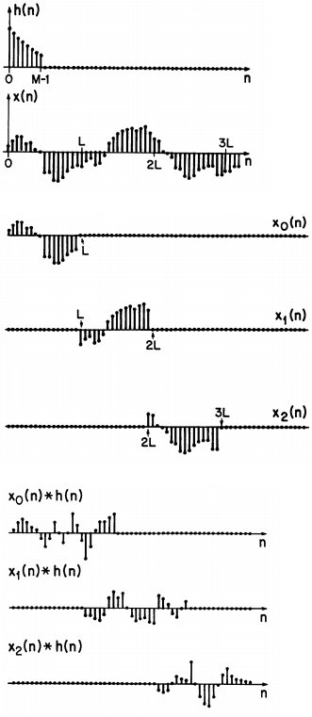
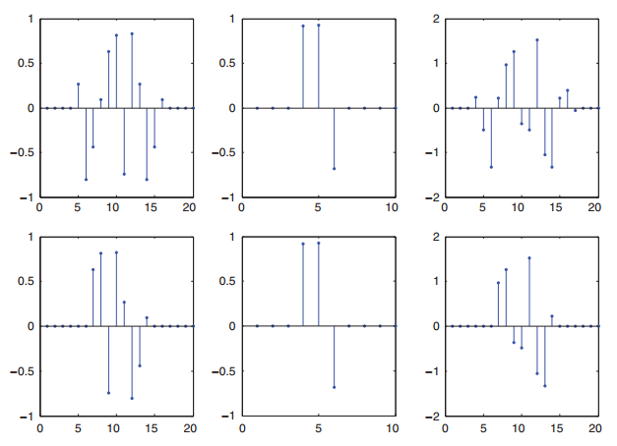
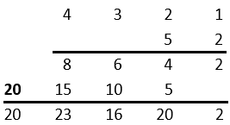
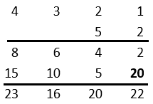
Fourier coefficients of

Slide 11
Drawbacks of OFDM
High out-of-band (OOB) emission: rectangular pulses in the time domain leads to a slowly decaying in the frequency domain, this makes OFDM unsuited for use in fragmented spectrum scenarios; in 4G OOB emission controlled by inserting null tones at the spectrum edges or filtering the whole OFDM signal with a selective filter(filtered-OFDM, longer CP), both lead to a loss in spectral efficiency, high inter-carrier interference (ICI) and severe adjacent-channel interference (ACI)
Cyclic prefix (CP) degrades spectral efficiency
The need for strict frequency and time synchronization among blocks and subcarriers(maintain orthogonality) does not match well with the IoT scenario, wherein many devices have to access the channel with short data frames. Also a key issue in the uplink of a cellular network wherein different mobile terminals transmit separately, and in the downlink when base station coordination is used

Slide 12
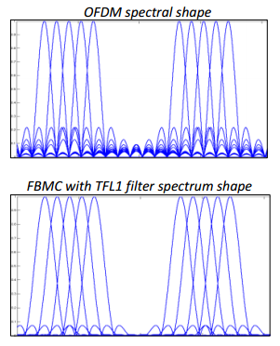
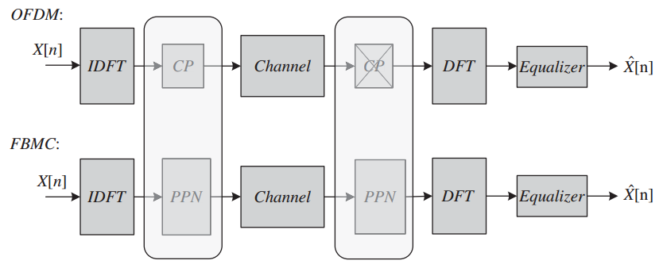
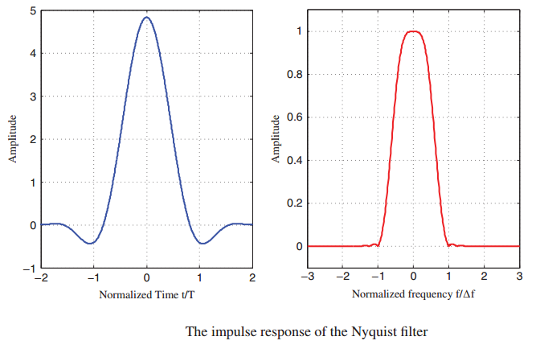
Filter-bank Multicarrier (FBMC)
No time overhead, add filter p(t) (termed “prototype” filter) for each subcarrier to suppress ISI

Slide 13
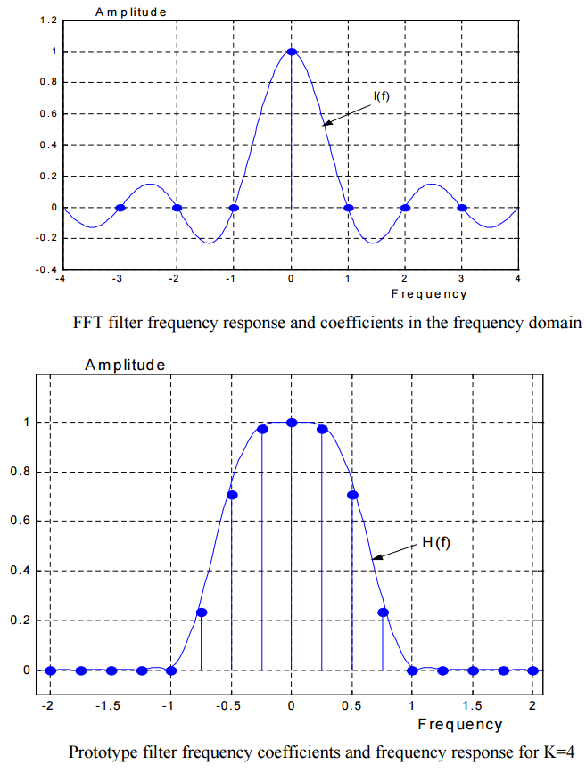
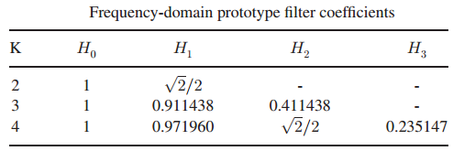
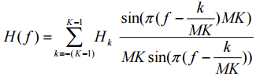
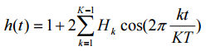
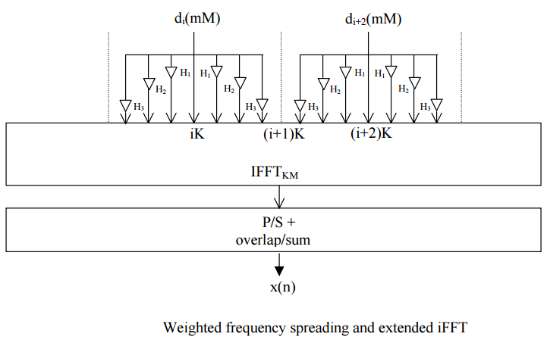
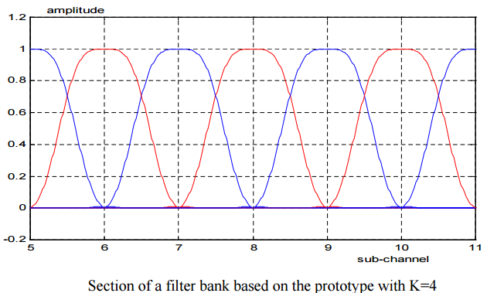
Prototype filters are characterized by the overlapping factor K, which is the ratio of the filter impulse response duration to the multicarrier symbol period T. The factor K is also the number of multicarrier symbols which overlap in the time domain. Generally, K is an integer number and, in the frequency domain, it is the number of frequency coefficients which are introduced between the FFT filter coefficients.

Slide 14
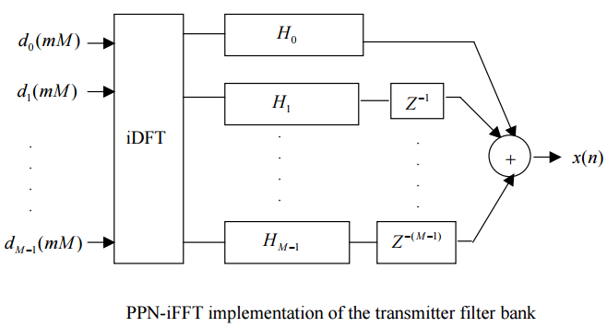
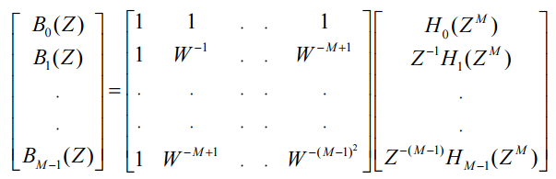
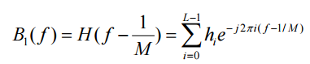
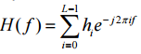
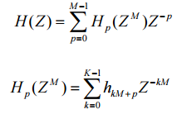
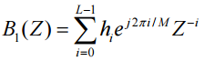
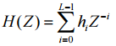
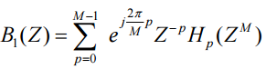
Polyphase network-FFT(PPN-FFT) implementation proposed to reduce the computational complexity
FBMC in massive MIMO has the impact of reducing (i) complexity; (ii) sensitivity to carrier frequency offset (CFO); (iii) (PAPR); (iv) system latency; and (v) increasing bandwidth efficiency.

Slide 15
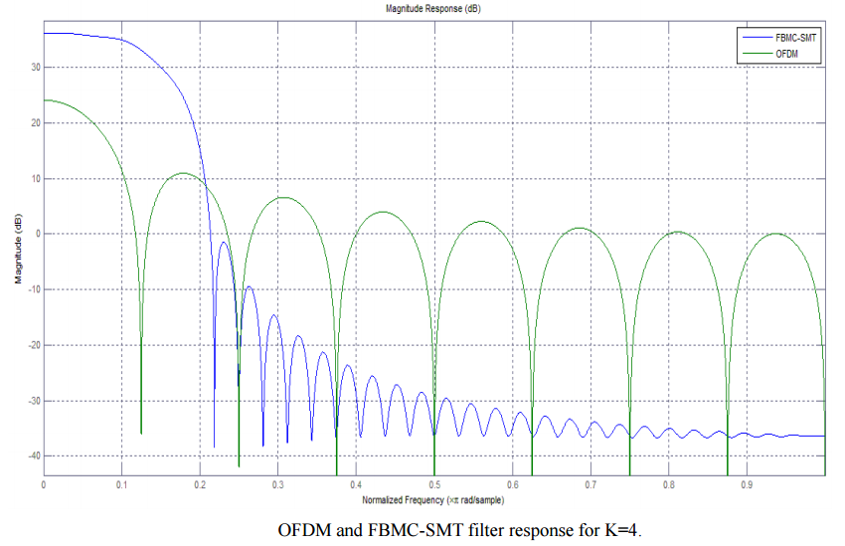
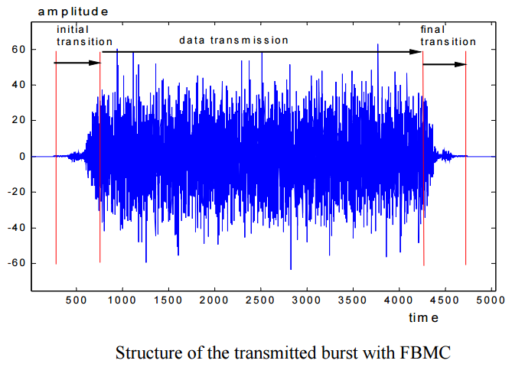
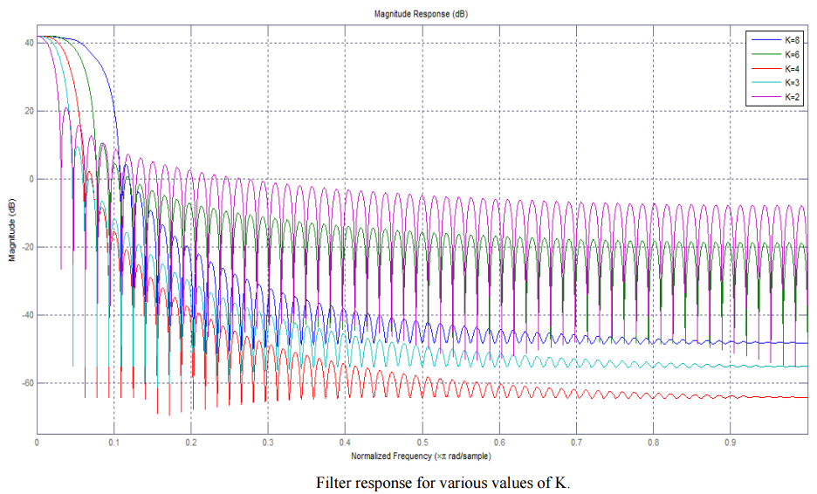
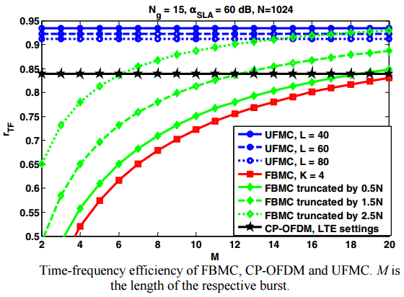

Slide 16
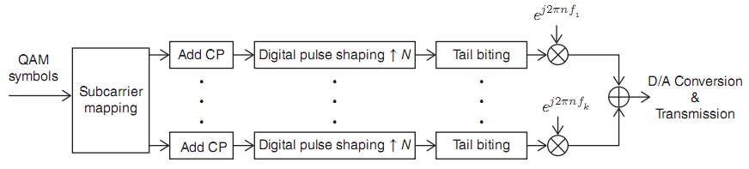
Generalized Frequency Division Multiplexing(GFDM)
A pure multicarrier modulation with low OOB emissions, suit for fragmented spectrum
Ues of CP, retains OFDM advantages: robust to multipath channels, ease of equalization, eficiently implemented
16
Notes:
16

Slide 17
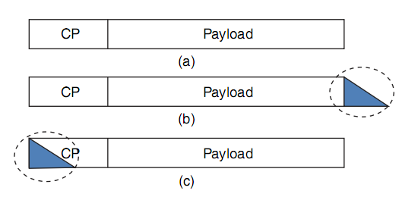
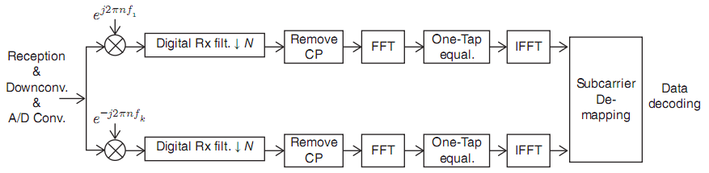
CP > impulse responses of
(shaping filter + channel + receive filter)
Tail-biting technique is an eficient strategy, the transmit filter impulse response length is not taken into account
One possible receiver architecture is as below, equalized data signal is obtained from IFFT
17
Notes:
17

Slide 18
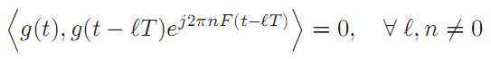
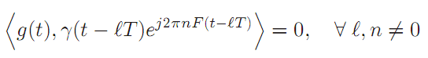
Bi-orthogonal Frequency Division Multiplexing(BFDM)
Prototype filter g(t) of classical OFDM should be orthogonal to a suitable time-frequency shifted version of itself
Implies that the same filter is used at the transmitter and receiver
per-fect demodulation (in the noiseless case) can also be obtained when the receiver employs a different receive filter γ(t)
Provide lower ICI and ISI
Introduce additional degrees of freedom
18
Notes:
18

Slide 19
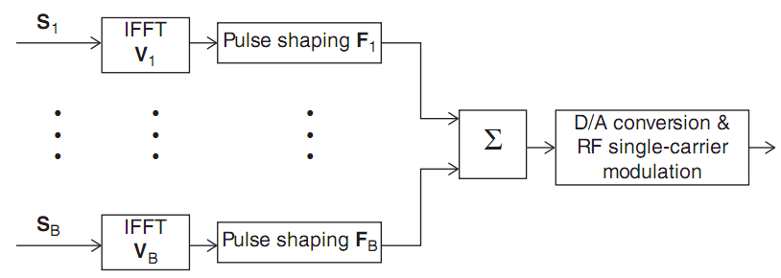
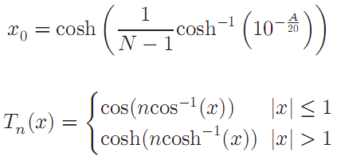
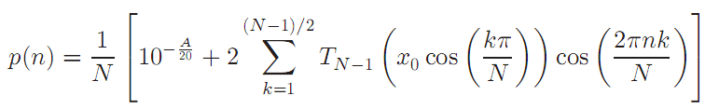
Universal Filtered Multicarrier(UFMC)
Subcarriers are filtered in groups
Dolph-Chebyshev(DC) pulse has been recommended for the UFMC modulation
19
Notes:
19

Slide 20
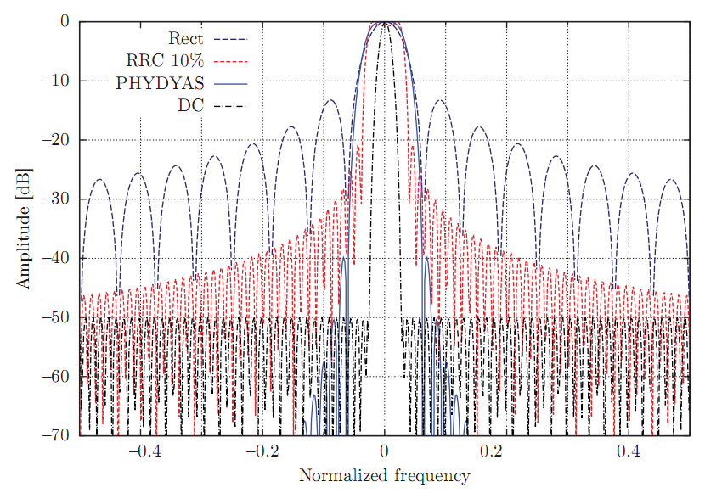
The DC pulse minimizes the main lobe width for a given sidelobe attenuation; RRC pulse: minimize ISI; the PHYDYAS pulse: discrete-time pulse for FBMC
Alternatives to the rectangular pulse adopted: compromise between their side lobe levels in the frequency domain, and their extension in the time-domain.
20
Notes:
20

Slide 21
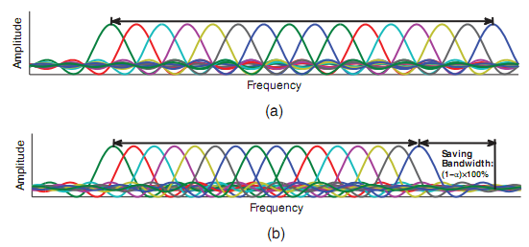
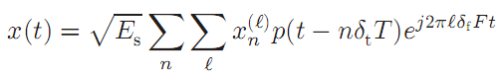
Faster-than-Nyquist(FFT) Signaling
Finite-order constellations are used, it is possible give up the orthogonality condition
FTN signaling is a linear modulation technique that reduces the time spacing between two adjacent pulses(the symbol time) to well below that ensuring the Nyquist condition,thus introducing controlled ISI
The turbo method is more or less identified with FTN, close to Shannon limit

Slide 22
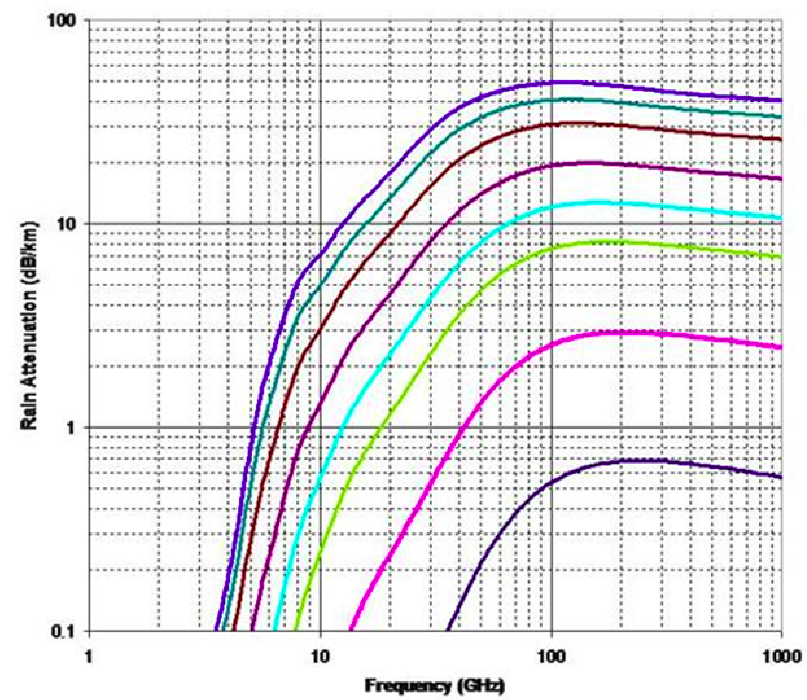
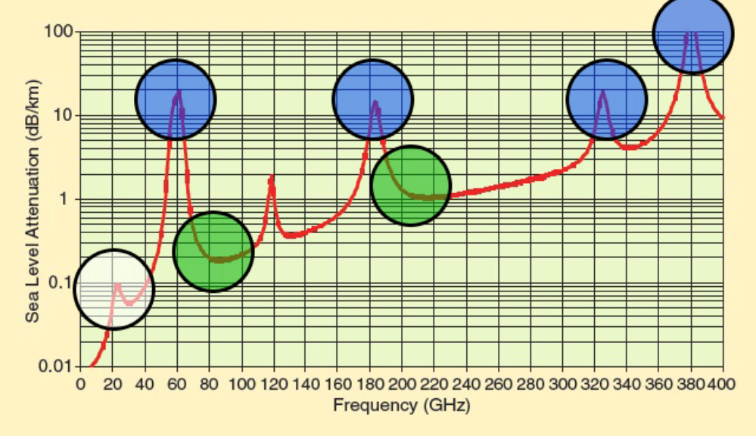
Single-carrier Schemes
mmWaves channel models based on measurements, pass loss proportion huge, have oxygen and rain absorbtion
Propagation attenuation of mmWaves make them a viable technology only for small-cell, dense networks, where few users will be associated to any given base station.
mmWaves operated together with massive MIMO to overcome propagation attenuation. This makes digital beamforming unfeasible, since the energy required for DA and AD conversion would be huge. Thus, each user will have an own radio-frequency beamform, which which requires users to be separated in time rather than in frequency.
22

Slide 23
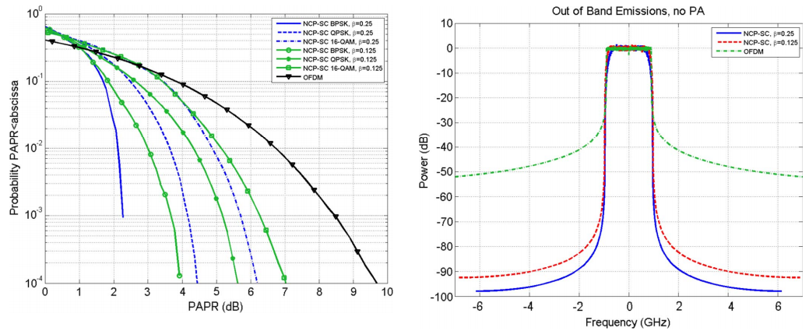
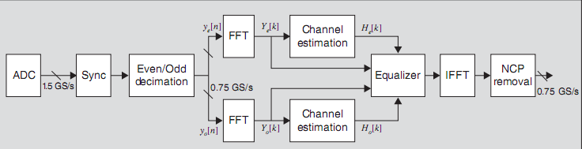
The null cyclic preix is part of the transmit symbol, it possible to adapt the length of the prefix of each user without disrupting the frame timing(slots, size, length), because the length of each user’s transmit symbol is always kept constant to N.
The NCP-SC has a much lower PAPR and much lower OOB emissios than OFDM
The presence of time intervals in which no useful data are present makes it easier to estimate the interference-plus-noise power at the receiver
A more IFFT operation is required for Null CP Single Carrier
23

Slide 24
What is the “best”?
It depends, each scheme has its pros and cons
E.g. :
UFMC, no CP, low sidelobe, overcome ICI;
FBMC, no CP, low sidelobe but long shaping filter, low efficiency in IoT;
GFDM, great flexibility; FTN, max throughput
PHY-layer functions will be partly virtualized and implemented in a data-center.
In future the modulation scheme itself might be changed according to the operating scenario in a SDN framework.
24

Slide 25
我们的全部通信无非幻影，各人只是在给自己写信。 ——纪德《窄门》
Long Zhang
Hardware Engineer
Tieto Oyj, ZSR Product Development Services /
long.a.zhang@tieto.com

